Slide 1

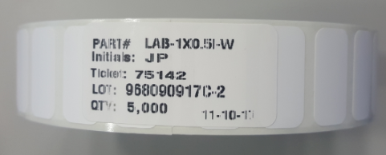
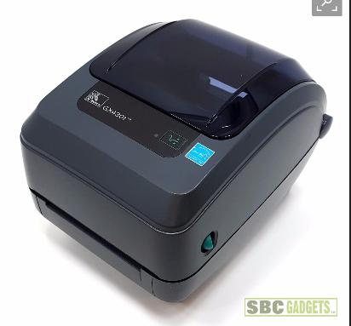
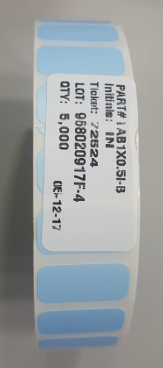
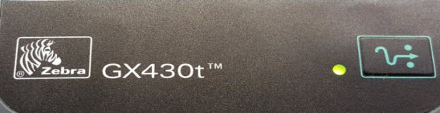
QR Label material requirements
Type | Printer | QR Label
Model or Part # | Zebra GX430t Desktop Thermal Printer | LAB1X0.5I-B / LAB1X0.5I-W
Shop & Contact | Website : www.zebra.com | Email: royce.smith@adlabel.com
 |  | Tel: 469-877-6228
* Use for only NEW Parts
* Use for Reclamation Parts

